Slide 1

EXPLORATORY DATA ANALYSIS
On IMDB 1000 MOVIES DATASET
By – Deepak Siriboyina

Slide 2
Movie Industry has been thriving since the late 1890s. But in the past 2 decades, it has seen a rapid and enormous growth owing to the web 2.0 and digitalization, OTT streaming etc…

Slide 3
Movies are here for more than 100 years and there may not be an end to the Industry as it has became a common point of entertainment for many people irrespective of demographics. - After all these years, is there any secret formula for movie making in order to generate more Revenue ?

Slide 4
Of course, the Industry may be a means of entertainment for other people, but the artists and the people investing in the industry need to make a living and every tide makes its mark. - Lets have a look at what we can do with our data and see if we could draw any actionable Insights to the film makers?

Slide 5
Observations made from the raw data :
There are 13 features with 1000 observations in the dataset.
192 (19.2%) cells have missing values.
Most of the missing values are from the Revenue (Millions) feature and the rest belong to the Metascore feature.
Revenue (Millions) and Metascore are highly correlated to each other.
Metascore and Rating are also highly correlated to each other.

Slide 6
After performing the following operations, the irregularities observed previously have been nullified.
Data Pre-Profiling
Data Pre-Processing
Data Post-Profiling

Slide 7
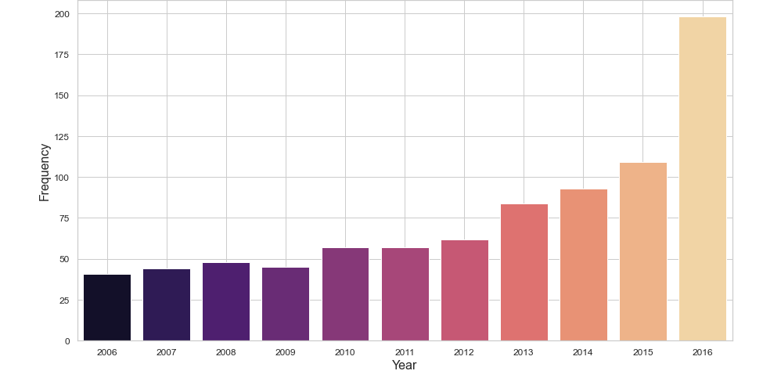
What is the trend of movie making along the years ?
Gradual increase of movies released from 2006 to 2015.
Abrupt growth of movies released from 2015 to 2016.

Slide 8
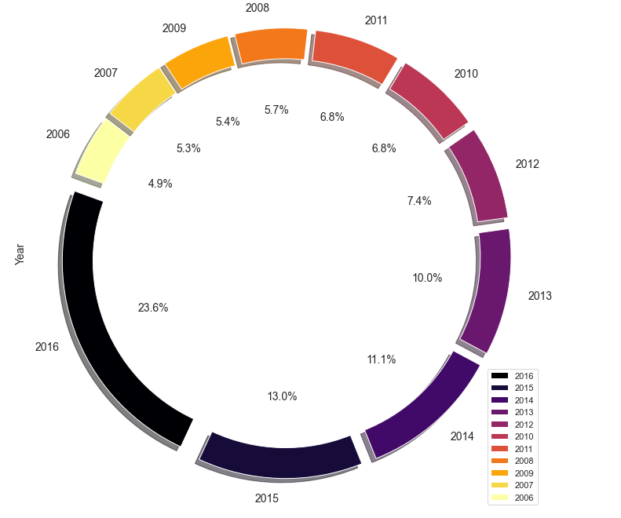
Donut plot showing the proportion of movies released every year.
We can see that there is an increase of 18.7% movies from 2006 to 2016.
We can also find the there is a abrupt increase of 10.6% movies released in the year 2016 from 2015.

Slide 9
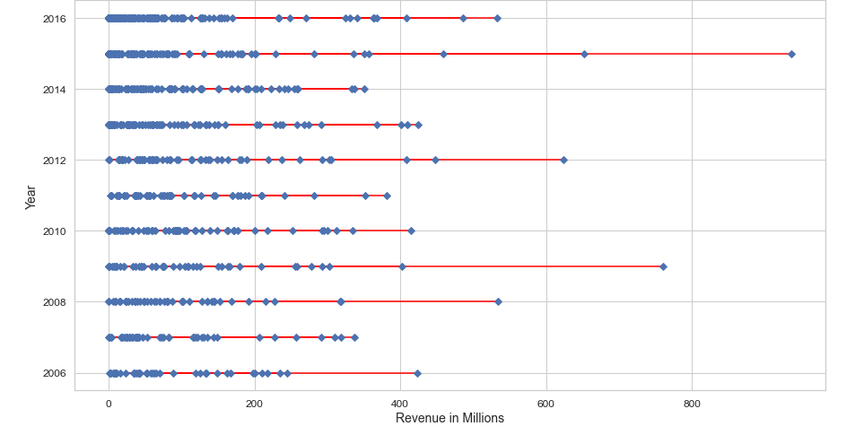
Revenue over the Years
2015 can be called as the best year for the industry in terms of Revenue generated.

Slide 10
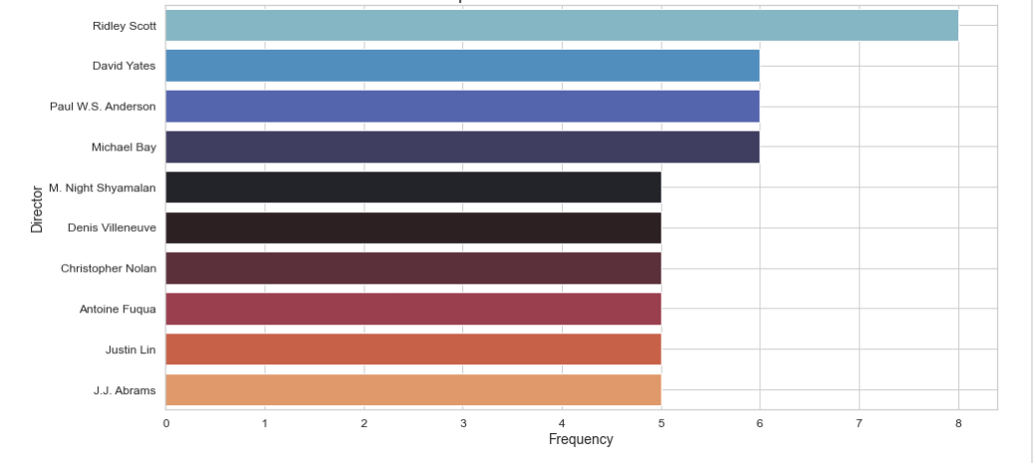
Which directors contributed most in the past decade?
Ridley Scott topped the list with 8 releases followed by David Yates, Paul W.S Anderson & Michael Bay.

Slide 11
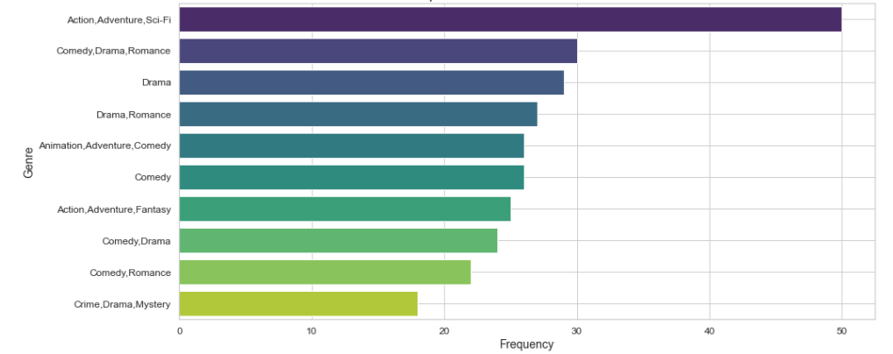
Which Genres have been dominating the market?
We can make a point that Action, Adventure and Sci-Fi are the top genres.

Slide 12
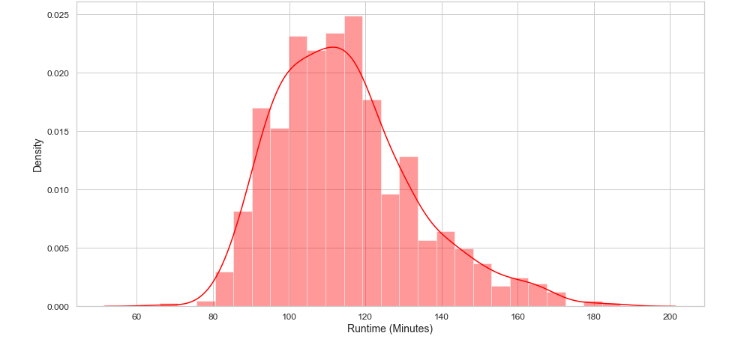
What is the average duration of a movie ?
It is found to be that most movies are having a duration of about 1 hr.. 40 min to 2 hrs.

Slide 13
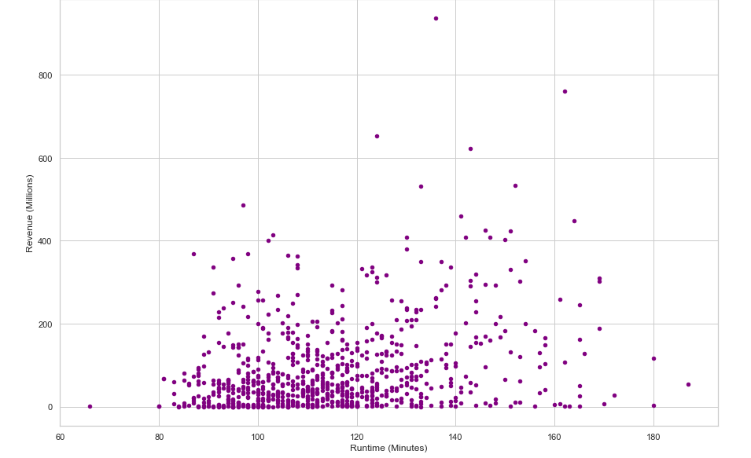
How does the runtime of a movie related to the movie's box office performance (Revenue) ?
Most movies with Revenue greater than 400 million dollars are the ones with Duration longer than 120 min.

Slide 14
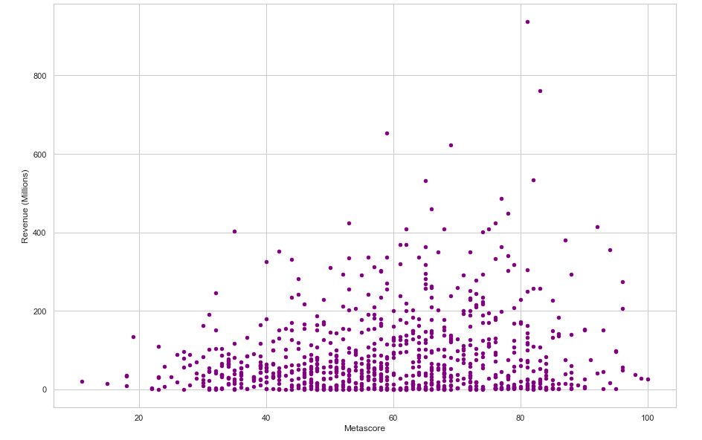
Does Metascore matters in making the most revenue, if so what impact it has on a movie's box office performance (Revenue) ?
Most movies with Revenue greater than 400 million dollars are the ones with Metascore greater than 60/100.

Slide 15
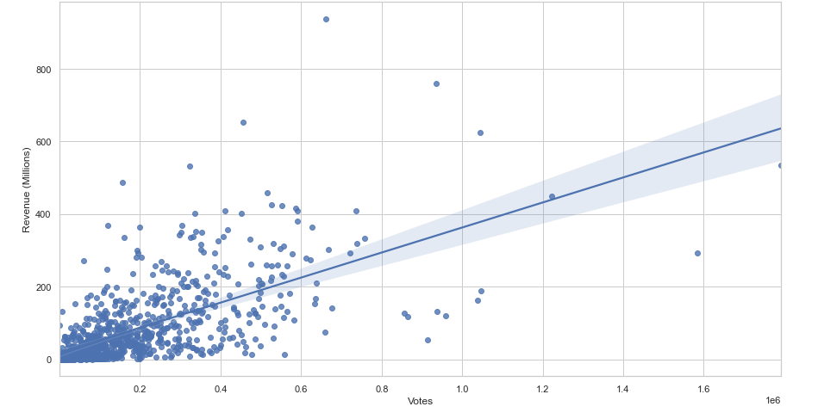
How are Revenue and Votes of a movie related ?
Most movies with Revenue greater than 400 million dollars are the ones with Votes greater than 400,000.

Slide 16
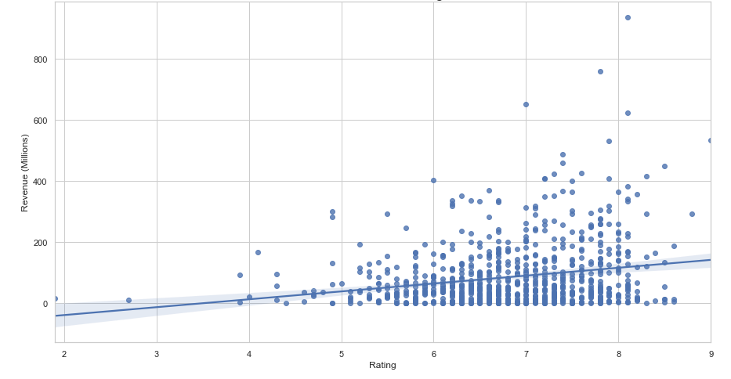
Does Rating matters in making the most Revenue ?
Most movies with Revenue greater than 400 million dollars are the ones with Rating greater than 7 out of 10.

Slide 17
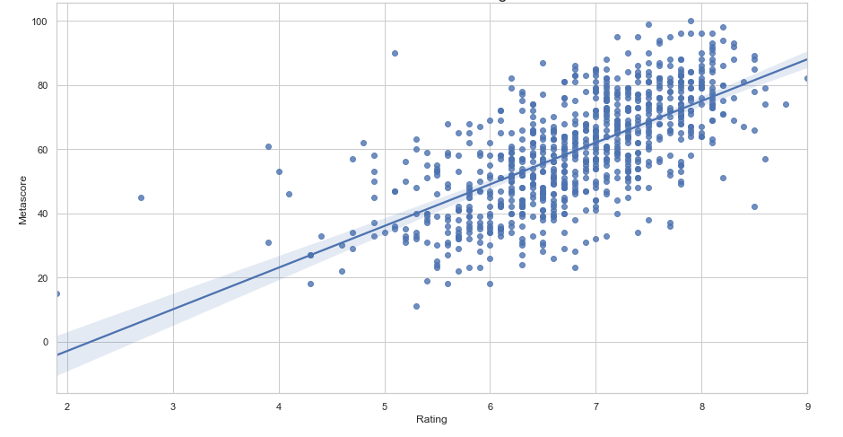
How are Rating and Metascore of a movie related ?
- It is clear that Metascore increases with the Rating and are directly proportional to each other.

Slide 18
An average of 84 movies are being released every year. 2016 produced most no. of movies 198 and 2006 produced least number of movies 41. Metascore and Rating are directly proportional to each other, which implies that Critics are having an influence on Audience Rating. The average Rating per movie is 6.8/10. The average Revenue generated per movie is 92 million dollars. The average Duration of a movie ranges from 1 hr. 40 min to 2 hrs. Most profitable movies are the ones with high Metascore and Rating.
Few insights found during Exploratory Data Analysis:

Slide 19
Conclusion:
By analysing the data in this way, we can uncover factors that contribute more to a movie's box office performance.
Duration, Genre and Metascore should be the primary concerns for film makers.
Revenue and Rating are directly proportional to each other, which implies that Revenue increases with higher Rating.
Again audience Rating is proved to be influenced by Metascore which is aggregated from the reviews of the critics all over the world.
Action, Adventure, Sci-Fi & Drama are found to be the top Genres to consider for generating more revenue.

Slide 20
Actionable Insights:
All in all, in order to higher revenue out of a movie, the film makers need to consider about the following:
To fix the Duration of the movie in the range 1 hr. 40 min to 2 hrs.
Chose the top performing Genres
Achieving high Metascore from the Critics.
Average Audience Rating higher than 7/10
Votes do play a role in making the movie popular, which in turn helps in generating more Revenue. - More Promotions , better Revenue.

Slide 21
THANK YOU

